Slide 1
startup analysis
File created on: 01-05-2021 09:59:58 AM

Slide 2
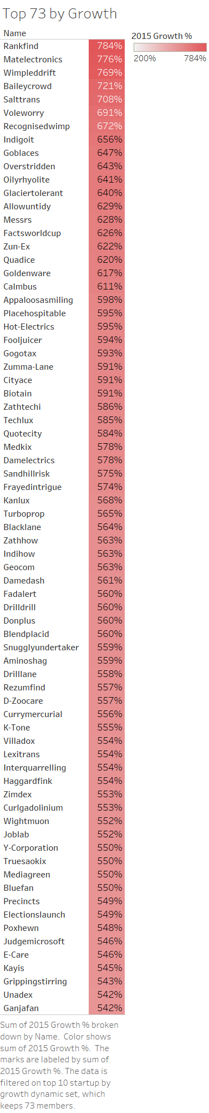

Slide 3
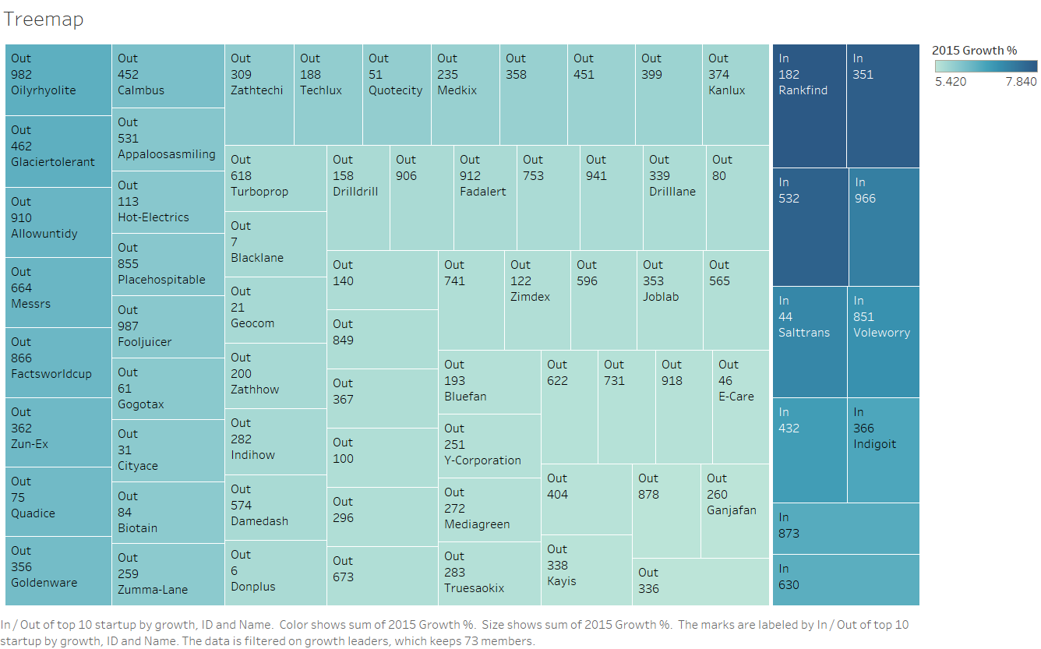

Slide 4
